Slide 1
An examination of psychological flexibility
as a moderator between Hispanic
undergraduates’ attitudes towards
LGBTQ individuals and willingness to
engage in behaviors that help the
LGBTQ community
Maureen K. Flynn, Ph.D.
Metropolitan State University of Denver

Slide 2
I have not received and will not receive any
commercial support related to this
presentation or the work presented
in this presentation.
Maureen K. Flynn, Ph.D.
Metropolitan State University of Denver

Slide 3
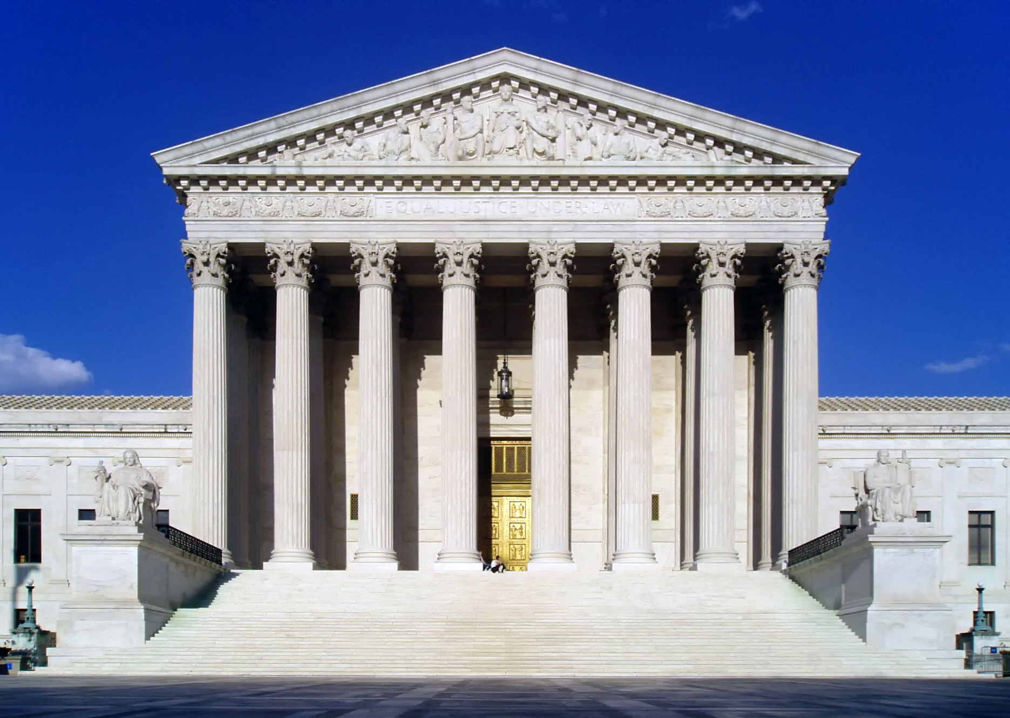
Current Context
Notes:
I also want to discuss the current societal context because that influences the way some LGBTQ individuals view themselves and behave.
There are a lot of things moving in the right direction for LGBT individuals. For example,
Last year around this timesupreme court will soon make a ruling that may allow same-sex marriage in all states.

Slide 4
Current Context
Notes:
LGBT individuals are more visible in the world around us. For example, there is an increase in the number of television shows with LGBT characters.

Slide 5
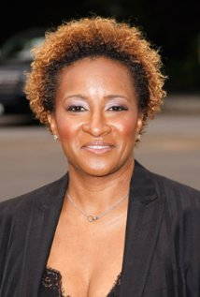
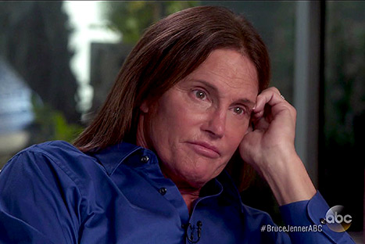
Current Context

Slide 6
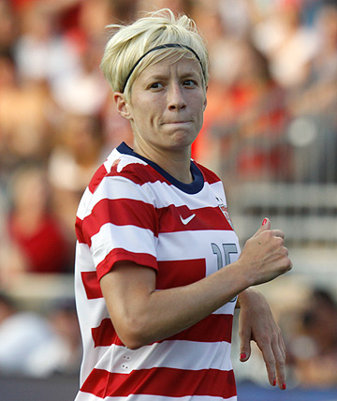
Current Context
Notes:
And in sports

Slide 7
Current Context
And
Notes:
There’s still a lot of discrimination and hate

Slide 8
Current Context
40% - Should not accept
(Pew Research Center, 2013)
Notes:
40% of Americans believe we should not accept homosexuality

Slide 9
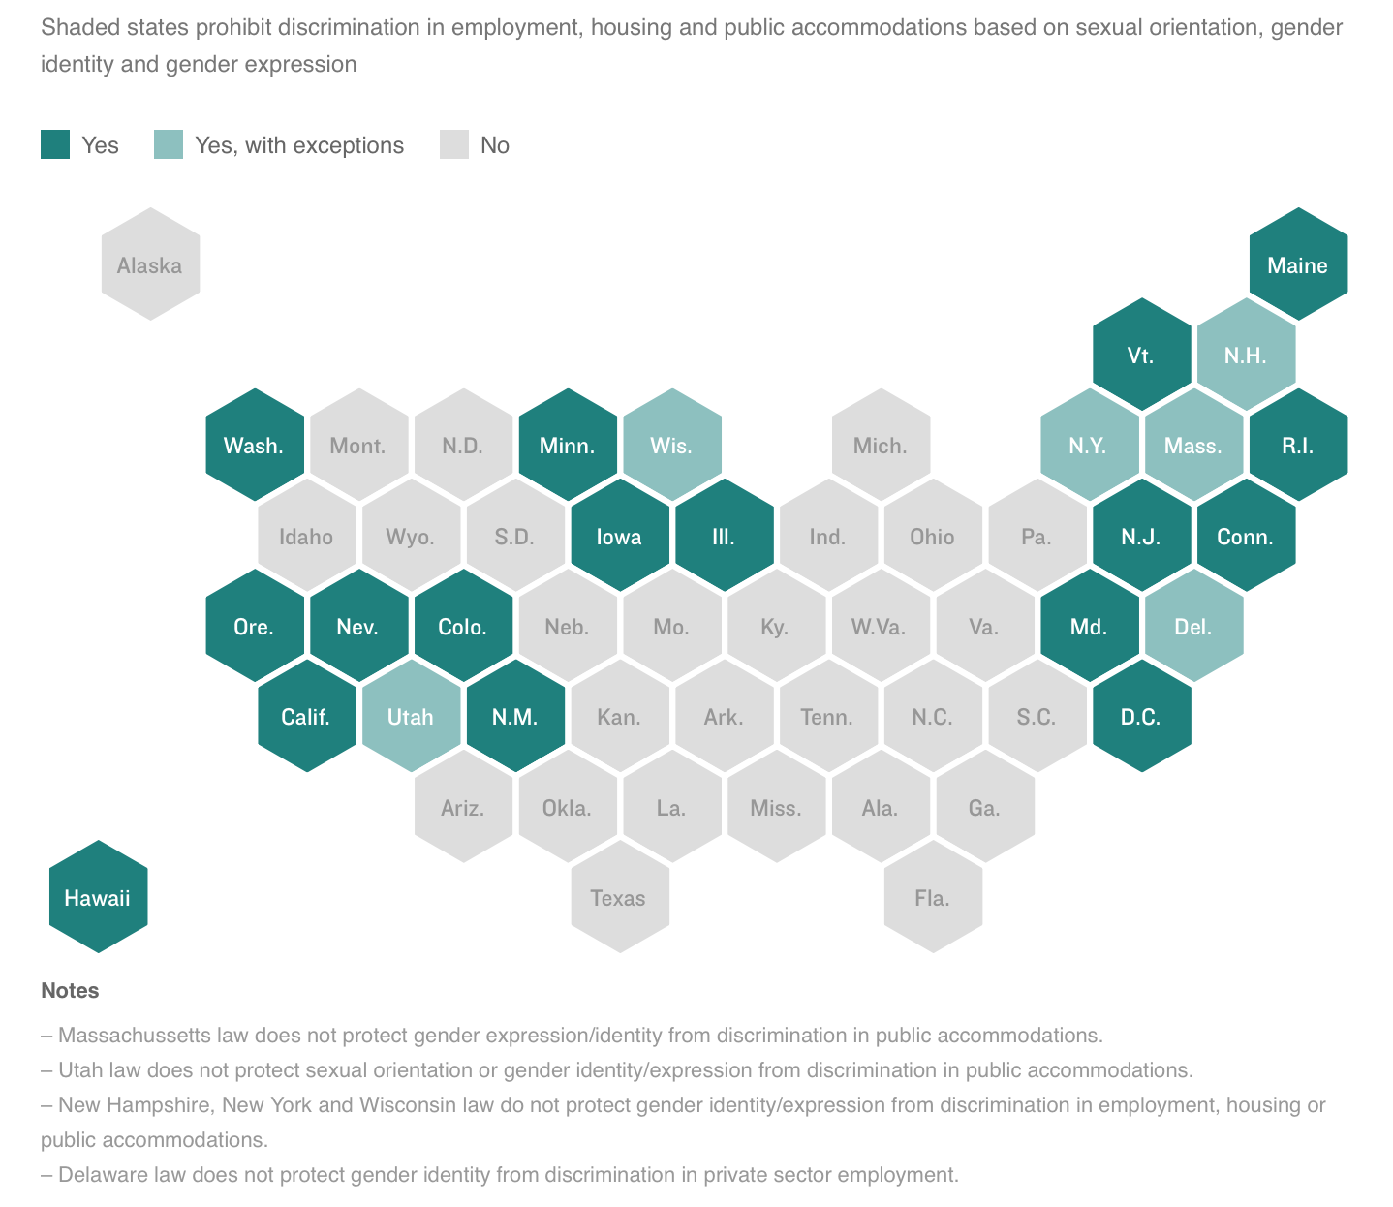
Current Context
Notes:
In most states it is legal to discriminate against LGBT individuals in the areas of employment, housing and public health

Slide 10
Current Context
Transgender – experience unemployment at twice
the rate as general pop
(Williams Institute, 2015)
Notes:
In most states it is legal to discriminate against LGBT individuals in the areas of employment, housing and public health

Slide 11
Current Context
Notes:
The law says it protects from discrimination claims anyone who believes that marriage is between one man and one woman, that sexual relations are reserved solely for marriage, and that the terms male and female pertain only to a person's genetics and anatomy at birth.
Under the law, religious organizations will be able to deny LGBT people marriage, adoption and foster care services; fire or refuse to employ them; and decline to rent or sell them property. Medical professionals will be permitted to refuse to participate in treatments, counseling and surgery related to "sex reassignment or gender identity transitioning.”
Meanwhile, people who adhere to the aforementioned beliefs may deny wedding services -- including DJing, dressmaking and limousine rental -- while employers and school administrators will be allowed to establish "sex-specific standards or policies concerning employee or student dress or grooming."
Employers and school administrators will be allowed to dictate access to bathrooms, spas, locker rooms "or other intimate facilities and settings," the law states.
The law also addresses the matter of government officials granting marriage licenses and performing ceremonies, an issue thrust into the spotlight last year when Kim Davis, a county clerk in Kentucky, spent five days in jail for refusing to give same-sex couples marriage licenses.

Slide 12
Current Context
58% - Subject to slurs or jokes
(Pew Research Center, 2013)
Notes:
58% of LGBT individuals reported that they have been subject to slurs or jokes because of their sexual orientation or gender identity (Pew Research Center, 2013).

Slide 13
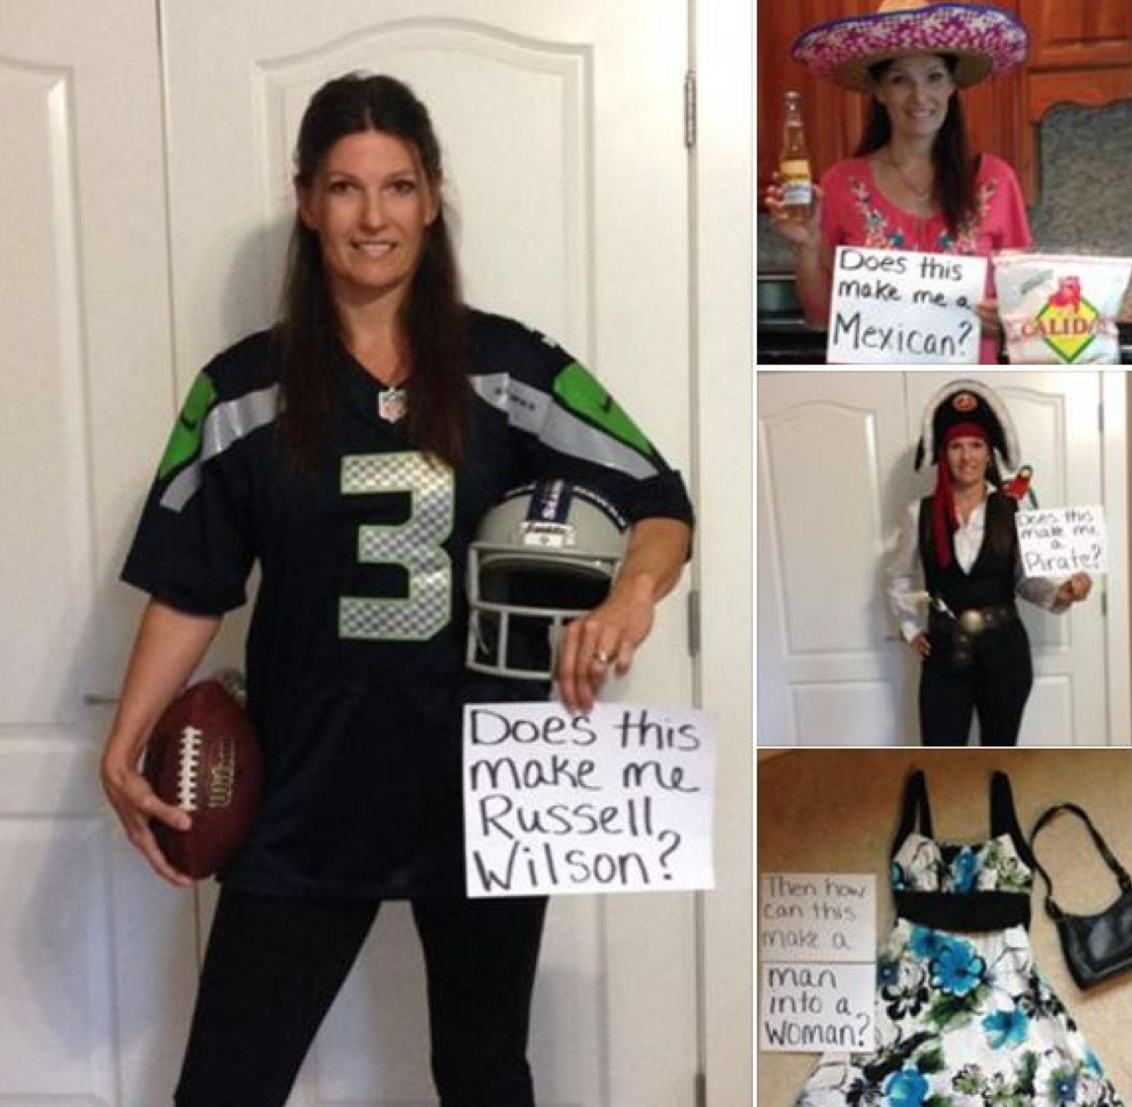
Current Context
Notes:
In most states it is legal to discriminate against LGBT individuals in the areas of employment, housing and public health

Slide 14
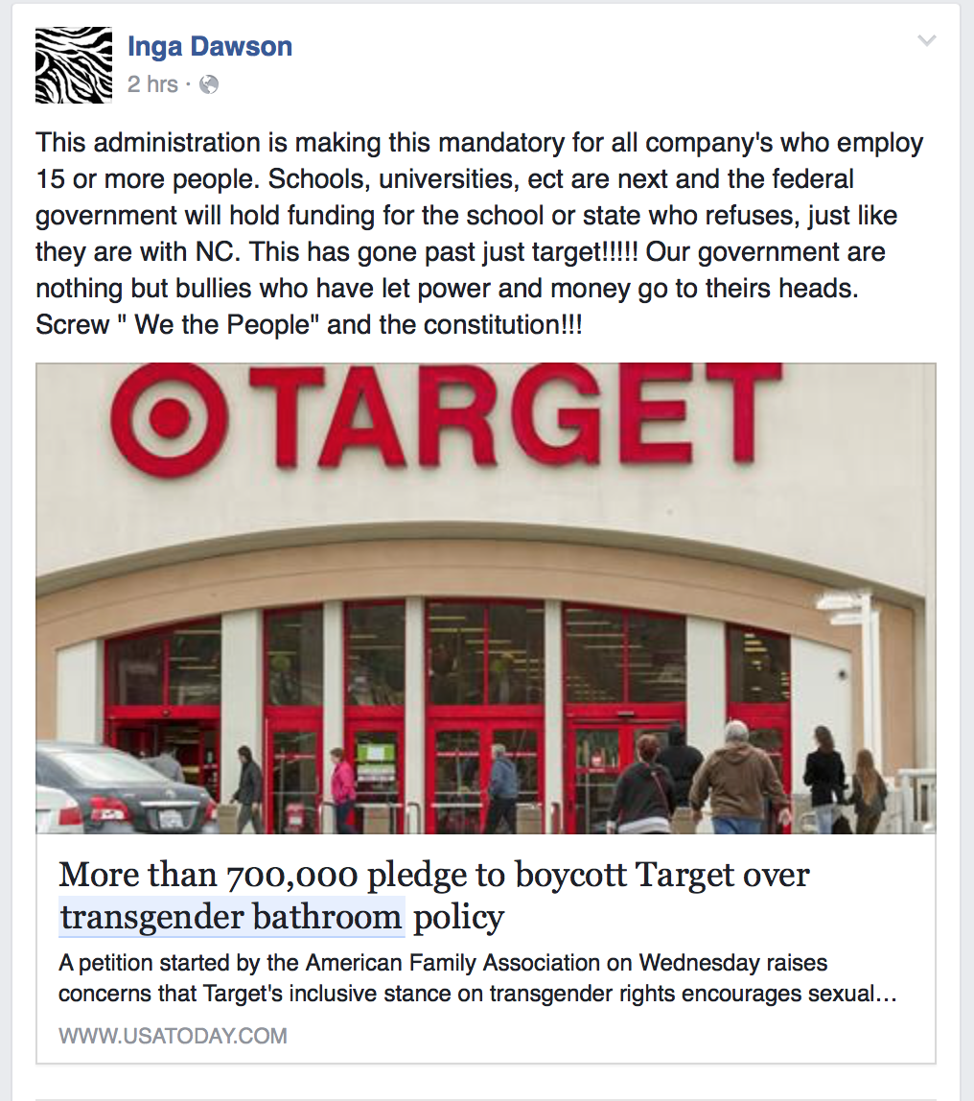
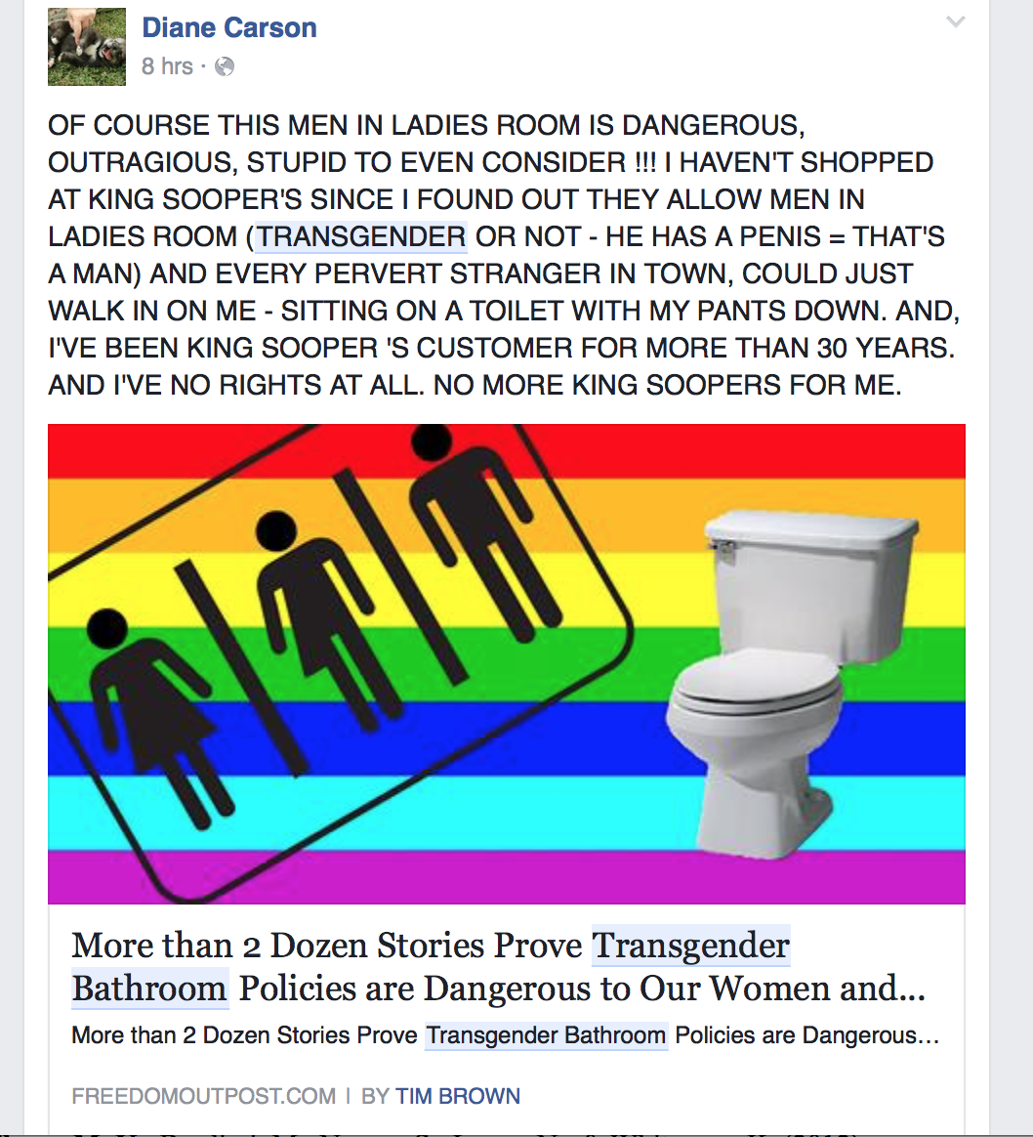
Current Context
Notes:
In most states it is legal to discriminate against LGBT individuals in the areas of employment, housing and public health

Slide 15
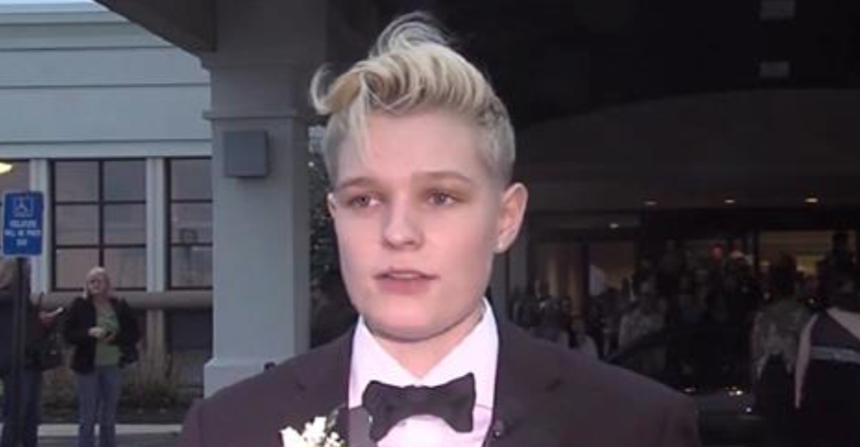
Current Context
Notes:
Kicked out of prom for wearing a suit, threatened to call the police if she didn’t leave

Slide 16
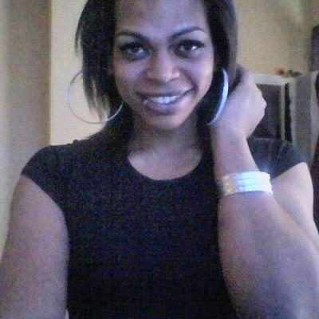
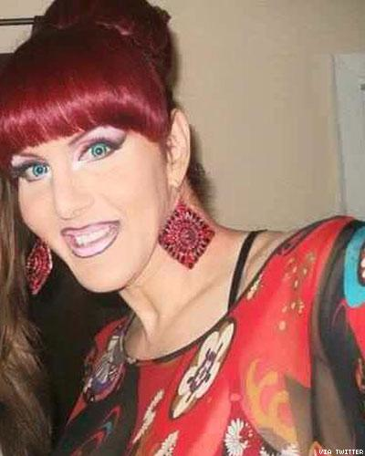
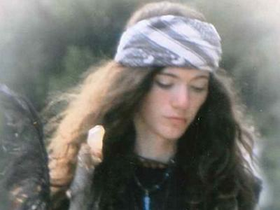
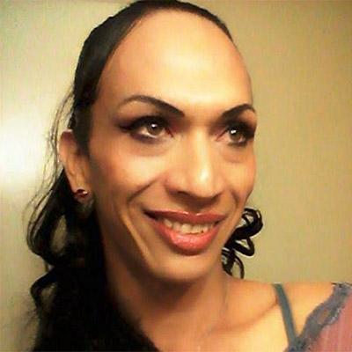
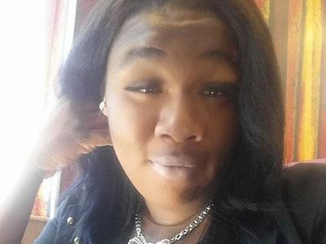
Current Context
Bri Golec
London Chanel
Kristina Gomez Reinwald
Penny Proud
Yazmin Vash Payne
Taja Gabrielle DeJesus
Notes:
Some of our transgender friends murdered in 2015. 22 murdered in 2015. of those 19 were transgender women of color

Slide 17
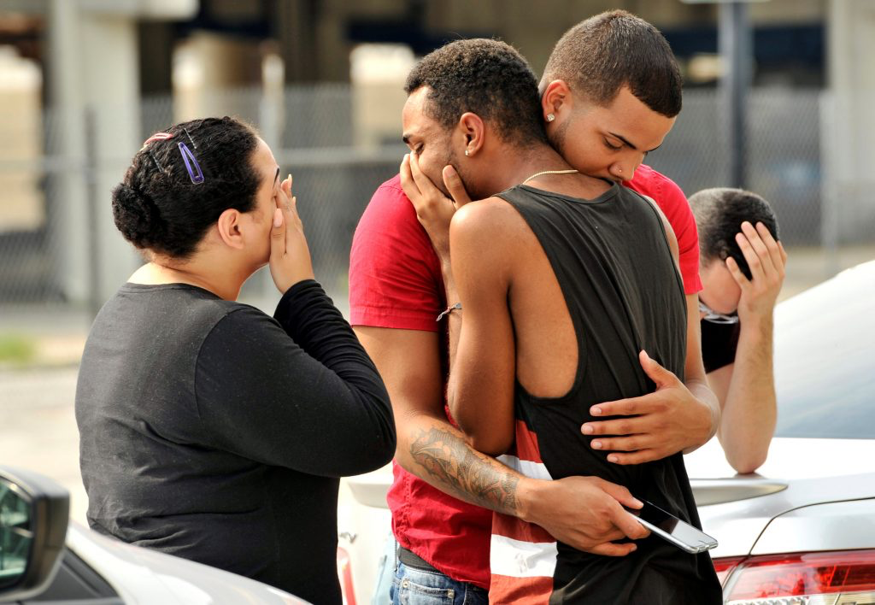
Current Context
Notes:
Some of our transgender friends murdered in 2015. 22 murdered in 2015. of those 19 were transgender women of color

Slide 18
Current Context

Slide 19
Current Context - LGBTQ Well-Being
Experience psychological and emotional distress at higher rates
LGBTQ adolescents more than twice as likely to have attempted suicide
25% of transgender youth reported suicide attempts
LGBTQ youth more likely to abuse substances
Notes:
With regard to well-being…
Small trangender study with 55 youth

Slide 20
Current Context
“I’m less than”
“I wish I wasn’t gay.”
“I’m a freak and don’t deserve to be loved.”
“I wish I didn’t feel like a boy inside.”
“I need to develop erotic feelings
towards the opposite sex.”
“My parents won’t love me anymore.”

Slide 21
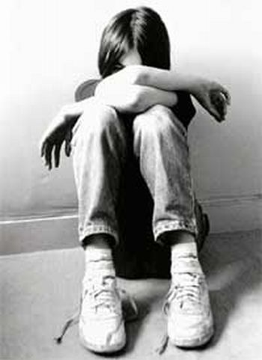
Ways to Target Stigma and Discrimination
Notes:
Because sexual and gender identity minorities are exposed to so many negative societal attitudes throughout their lives, many adopt them and apply them to themselves at least at some point during development. This also includes people who are questioning an LGBT identity/
This process has been referred to as internalized homophobia, or transphobia and has been identified as a contributing factor to psychological distress.
The term internatized homophobia has been widely used in the past but has been criticized for sounding pathologizing. I mention the term because a lot of research uses internalized homophobia.

Slide 22
Psychological Flexibility
Notes:
Acceptance and Commitment Therapy may be a means to help reduce the harmful effects of IH or IT
ACT is a is a behavioral therapy designed to increase psychological flexibility – the ability to engage in values based actions despite thoughts, feelings, memories and other private events.

Slide 23
Psychological Inflexibility
Psychological inflexibility toward stigmatizing thoughts is related to:
Right Wing Authoritarianism
Social Dominance Orientation
Empathy
Social distancing (ethnic minorities, obese individuals, gay men)
General prejudice
Notes:
Acceptance and Commitment Therapy may be a means to help reduce the harmful effects of IH or IT
ACT is a is a behavioral therapy designed to increase psychological flexibility – the ability to engage in values based actions despite thoughts, feelings, memories and other private events.

Slide 24
ACT and Stigma
ACT has also shown to reduce stigma towards
Substance-abusing clients
(Hayes, Bissett, et al., 2004)
Racial minorities
(Lillis & Hayes, 2007)
People with psychological disorders
(Masuda et al., 2007)

Slide 25
Hypotheses
1) Psychological inflexibility is positively correlated with homophophia and transphobia.
2) Psychological inflexibility aids in the prediction of willingness to engage in behaviors that would benefit the LGBT community.
3) Psychological inflexibility moderates the relationship between negative thoughts towards homosexuality and willingness to engage in behaviors that would benefit the LGBT community.

Slide 26
Method - Measures
Homophobia
Homophobia Scale
Behavior/Negative Affect
Affect/Behavioral Aggression
Cognitive Negativism
Total Score

Slide 27
Method - Measures
Homophobia
Self-Report of Behavior Scale

Slide 28
Method - Measures
Transphobia
Genderism and Transphobia Scale

Slide 29
Method - Measures
Psychological Flexibility
Acceptance and Action Questionnaire - II
Acceptance and Action Questionnaire - Stigma
Psychological Inflexibility
Psychological Flexibility
Total Score

Slide 30
Method - Measures
Social Dominance Orientation
Social Dominance Scale
Notes:
it is a measure of an individual's preference for hierarchy within any social system and the domination over lower-status groups

Slide 31
Method - Measures
Willingness items
Tuition money – LGBT center
Add name in local newspaper
Gender neutral bathrooms

Slide 32
Method - Measures
Attention Check Items

Slide 33
Procedure

Slide 34
Preliminary Examinations
369 participants
99 failed attention checks
20 univariate outliers
5 multivariate outliers
24 non-Hispanics
241 participants

Slide 35
Participants
241 undergraduates; 100% Hispanic
Sex - 74.6% female
Age – Mean 21.33 (SD = 4.93)

Slide 36
Participants
Country of Origin
83.8% United States
15.8% Mexico
4% Other

Slide 37
Participants
Familial ties to Mexico
83.3% Yes

Slide 38
Participants
Year in School
22.5% Freshman
26.3% Sophomore
26.3% Junior
25% Senior

Slide 39
Results

Slide 40
Results
Hypothesis 1: Psychological inflexibility is positively correlated with homophophia and transphobia.

Slide 41
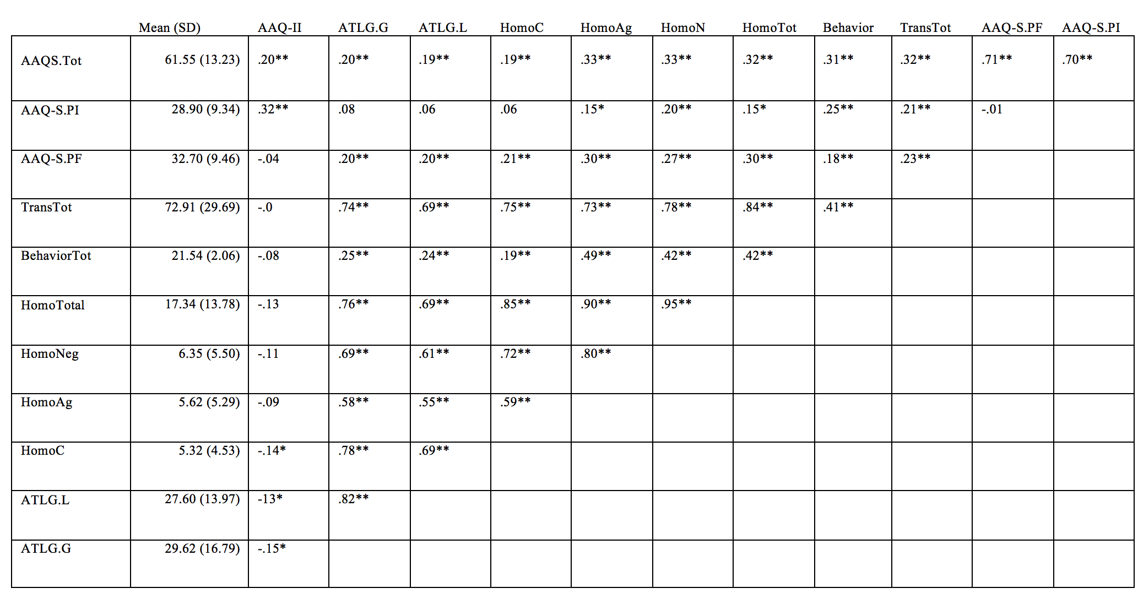

Slide 42
Notes:
.19-.33

Slide 43
Notes:
3 fewer sig relationships
.15-.32

Slide 44
Notes:
All homophobia and transphobia measures .18-30

Slide 45
Notes:
Only 2 homophobia measures .12-.14 (weaker correlations)

Slide 47
Results
Hypothesis 2: Psychological inflexibility aids in the prediction of willingness to engage in behaviors that would benefit the LGBT community.
Hypothesis 3: Psychological inflexibility moderates the relationship between negative thoughts towards homosexuality and willingness to engage in behaviors that would benefit the LGBT community.

Slide 48
Willingness Items
Would you be willing to allow us to add your name to a petition to the university to allocate tuition dollars ($5 dollars per student per semester) to help fund an LGBTQ resource center on campus?
No – 53.7%

Slide 49
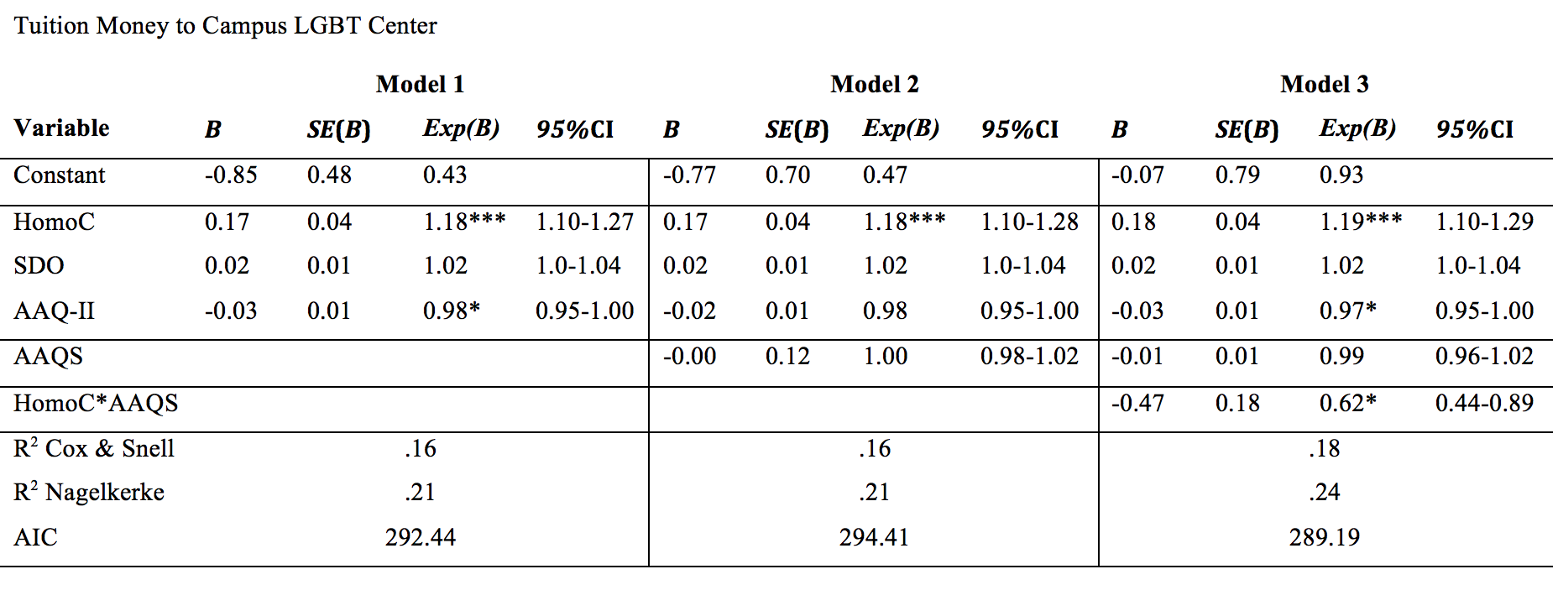

Slide 50
Willingness Items
At no cost to you, would you be willing to have us publish your name in the Monitor (RGV's newspaper) in October, indicating that you support LGBT students, faculty, and staff on campus.
No – 45%

Slide 51
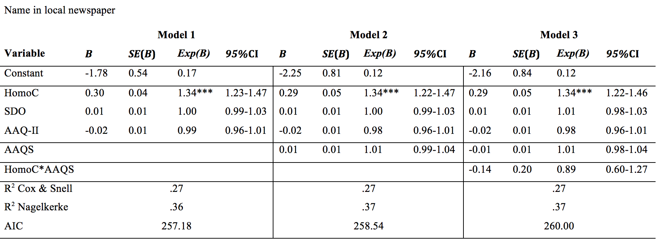

Slide 52
Willingness Items
Would you be willing to allow us to add your name to a petition to create some gender neutral bathrooms (restrooms available to people of all genders) on campus to provide a safe, comfortable place for transgender individuals to relieve themselves?
No – 39.2%

Slide 53
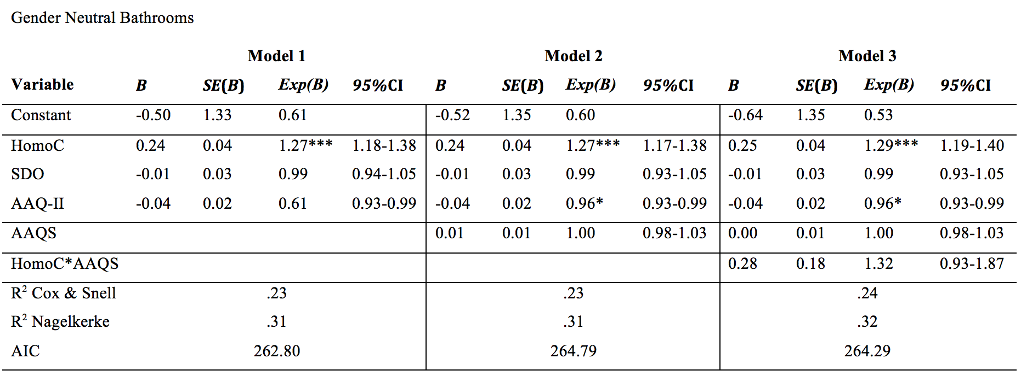

Slide 54
Discussion
Related to Attitudes
Prediction
Notes:
Didn’t or only weakly

Slide 55
Discussion
Problems with the AAQ-S
PCA and varimax
Factor structure not replicated with EFA
Method effects

Slide 58
Discussion
Actual Behavior Better than Assessing Willingness

Slide 59
Discussion
Diversity of Hispanics

Slide 60
Future Directions
Further Examine Psychometrics of AAQ-S
Utility of AAQ-S as a mechanism of action measure
Behavioral Measures of Discrimination or Helping Behaviors
Domain Specific Measure

Slide 61
Maureen K. Flynn, Ph.D.
mflynn13@msudenver.edu
Metropolitan State University of Denver

Slide 62
Need credit for this session?
Please don’t forget to
scan out.
What did you think?....
complete the 3 question quickeval
for this session at
https://contextualscience.org/quickeval
This was presentation was session # 46

